Slide 1

Trainers’ Training: Session 1
Measures to prevent DON contamination
MYCOHUNT
M. Eeckhout, G. Haesaert

Slide 2
Introduction
Mycotoxins: enormous impact on public health and agricultural practices
continuously prevent and control the incidence of mould infections and the associated mycotoxin production

Slide 3
The cereal production chain
FARM
COLLECTION
STORAGE
DISTRIBUTION
FOOD AND
FEED PRODUCTION

Slide 4

No DON without Fusarium Head Blight
the prevention and control of mould infections start in the field with good agricultural practices → GAP

Slide 5
No DON without Fusarium Head Blight
The main ideas behind GAP
  to reduce the amount of inoculum
  to prevent the dispersal of inoculum

Slide 6

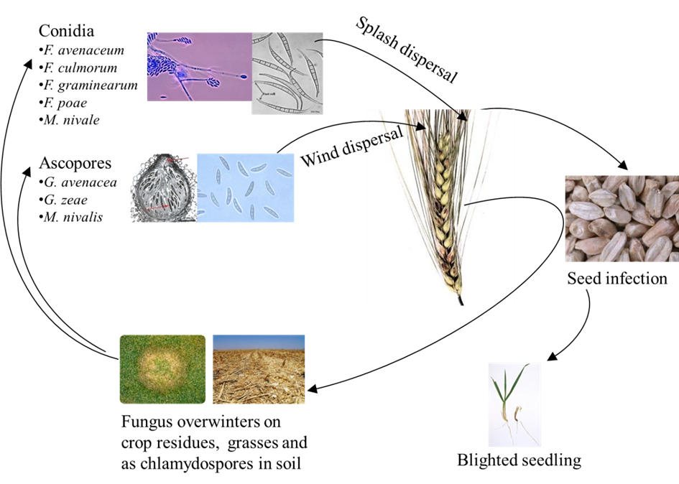

Slide 7
1. Choice of variety
Only use varieties recommended for a certain region
Choose a variety with a know host resistance for FHB

Slide 8
database of HoGent :
→ more than 100 varieties classified in five risk classes

Slide 9
2. Crop rotation
Alternating crops which are host for Fusarium with crops which are no hosts
Maize → Wheat
Potato → Wheat
HIGH RISK
LOW RISK

Slide 10
3. Crop planning
Avoid high temperatures and drought stress during seed development and maturation
Avoid wet periods during early flowering
Delaying harvest of infected crops may increase mycotoxin content
Planning to harvest the crop at low moisture content and full maturity
HIGH RISK
LOW RISK

Slide 11
4. Soil and crop management
Crop residues
Removal, destruction or burial of infected crop residues
Ploughing should especially be considered between two Fusarium susceptible crops
HIGH RISK
LOW RISK

Slide 12
4. Soil and crop management
Plant stress: drought, humidity, insects
Correct plant nutrition
Correct irrigation
Avoid insect damage
Fungicide treatment
HIGH RISK
LOW RISK

Slide 13
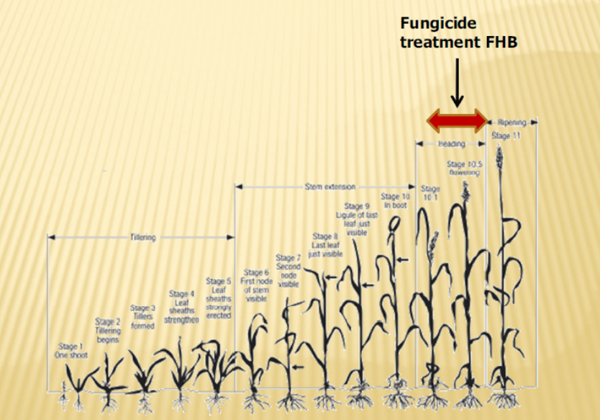

Slide 14
5. Harvesting
Moisture content
FHB infected parts of the field
Pre-harvest DON score
Segregation of food/feed
Difference clamp/clean/dry
HIGH RISK
LOW RISK

Slide 15
Risk decision tree
Rainfall during flowering yes/no = most important risk parameter
If no → ? Susceptible crop yes/no
If yes → ? Host crop (crop rotation) yes/no
If yes → susceptible cultivar yes/no
If no → susceptible cultivar yes/no → ploughing yes/no

Slide 16
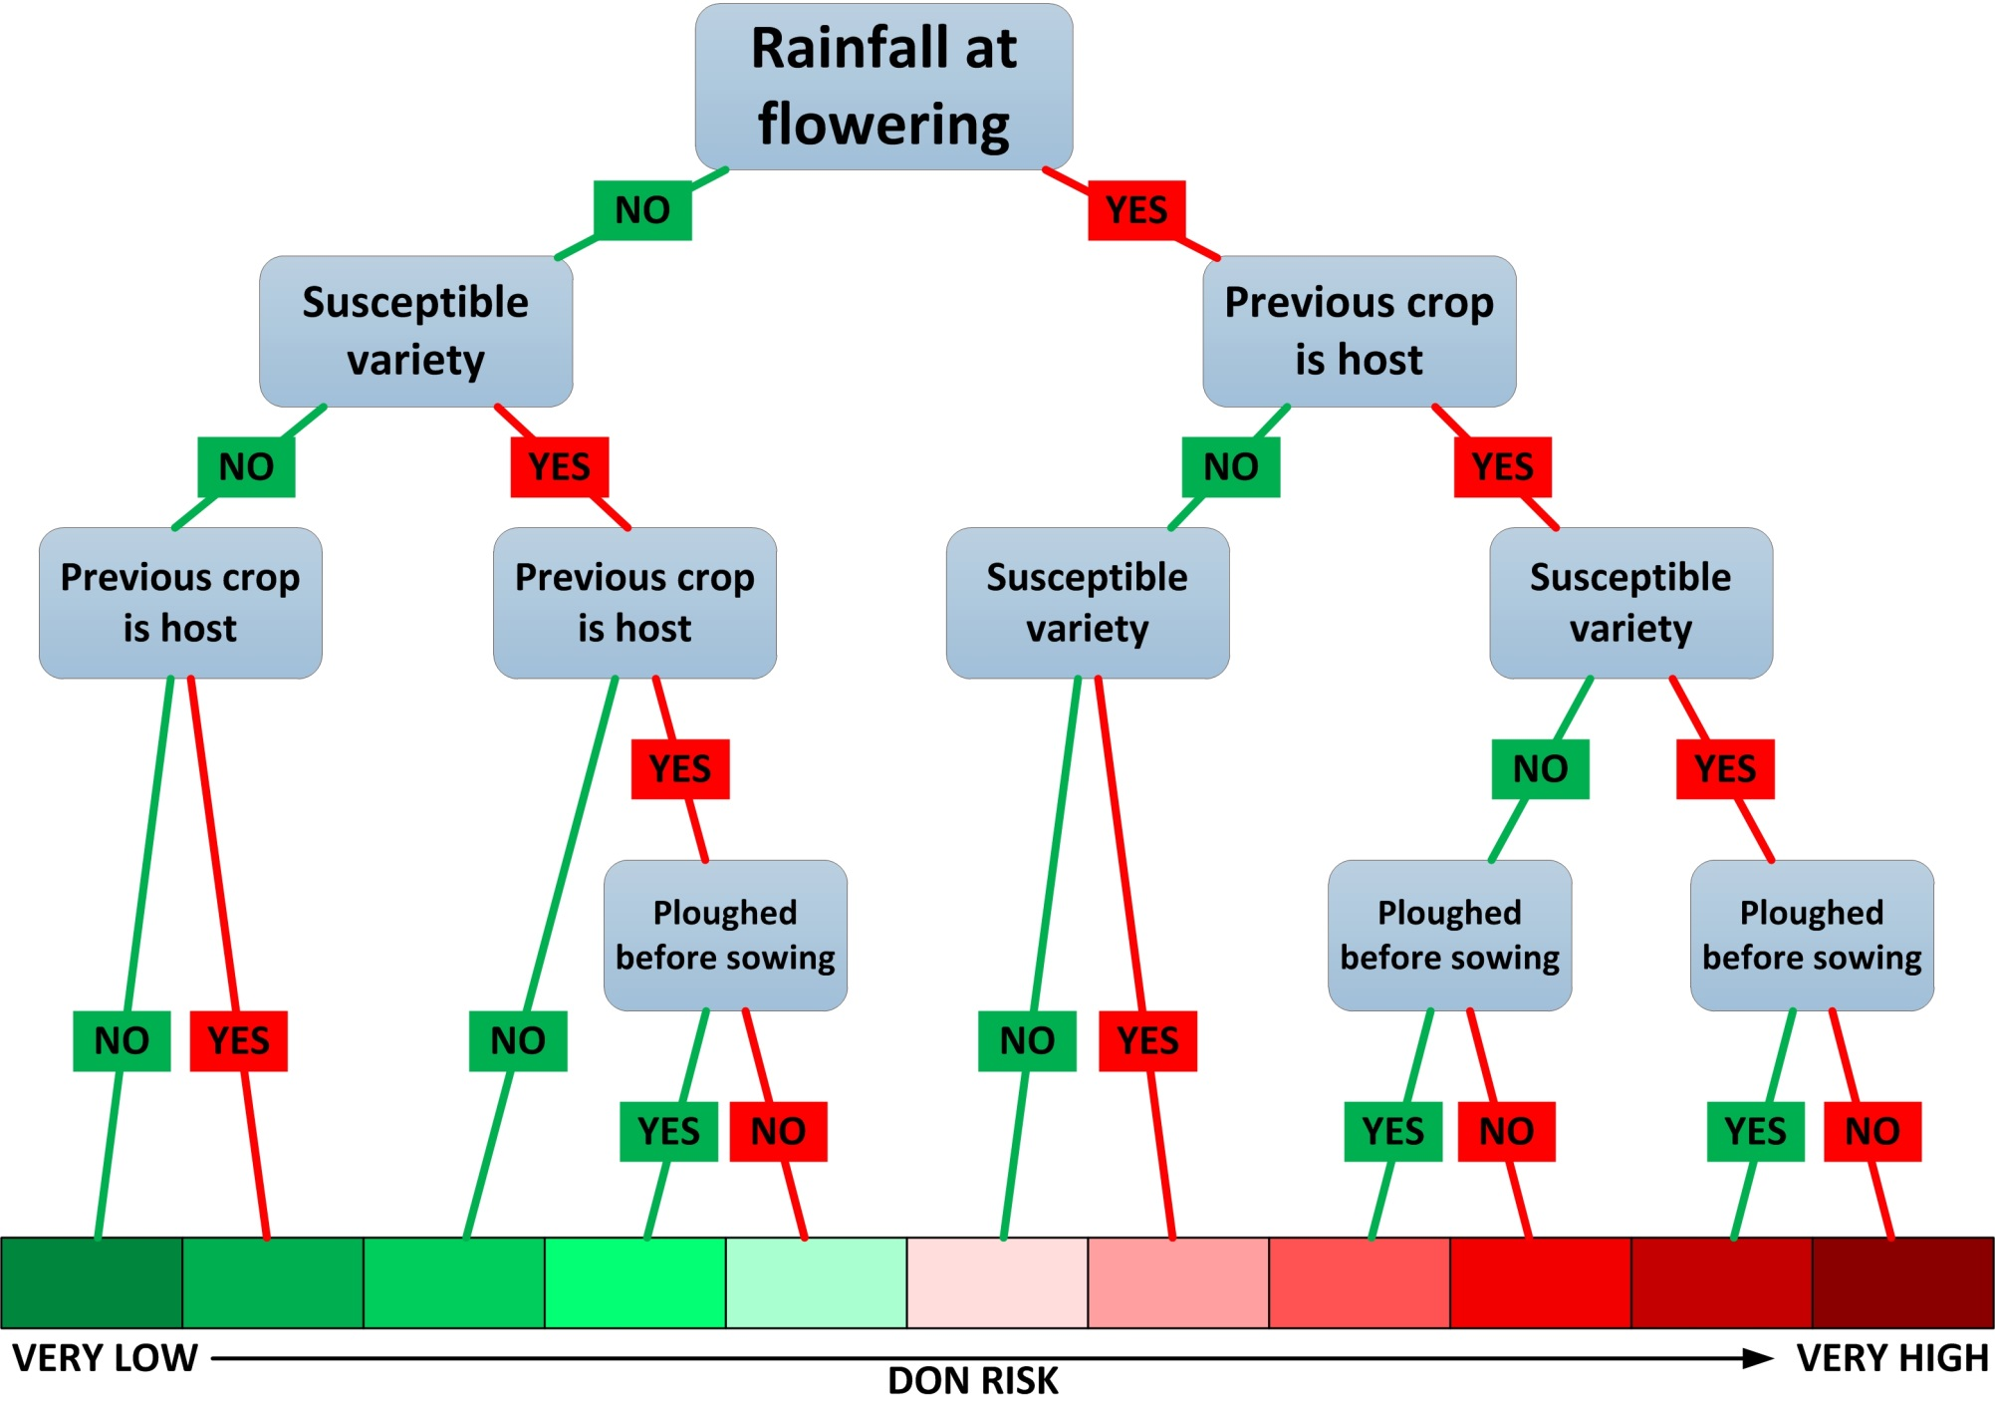

Slide 17
COLLECTION
1. Pre-selection based on quality
before allocating in to a certain storage facility (silo):
avoid mixing of parties of highly different quality
segregate based on the moisture content, protein content, hectolitre weight, crop data, presence of insects...

Slide 18
COLLECTION
2. Traceability
Track and Trace
Allocated Food – Feed
Important for traders !

Slide 19
COLLECTION
3. Drying
Store grains with high moisture content
Drying → moisture below ± 15 %
Method depending on moisture content at harvesting
HIGH RISK
LOW RISK

Slide 20
STORAGE
Good hygienic practices during storage
Quality control at intake
avoid contamination of stored products by the environment and cross-contamination between stored products
Good storage conditions
Pest control
Adequate cleaning of premises
LOW RISK

Slide 21
DISTRIBUTION
Good hygienic practices during transport
Clean and dry containers
No residues
Avoid rain
No pests and rodents

Slide 22
FOOD AND
FEED PRODUCTION
Before processing cereals
Quality control at intake → yes/no
Traceability check
Sampling and analysis

Slide 23
FARM
COLLECTION
STORAGE
DISTRIBUTION
FOOD AND
FEED PRODUCTION
For more detailed information on each section see guidelines for prevention of DON contamination

